Slide 1
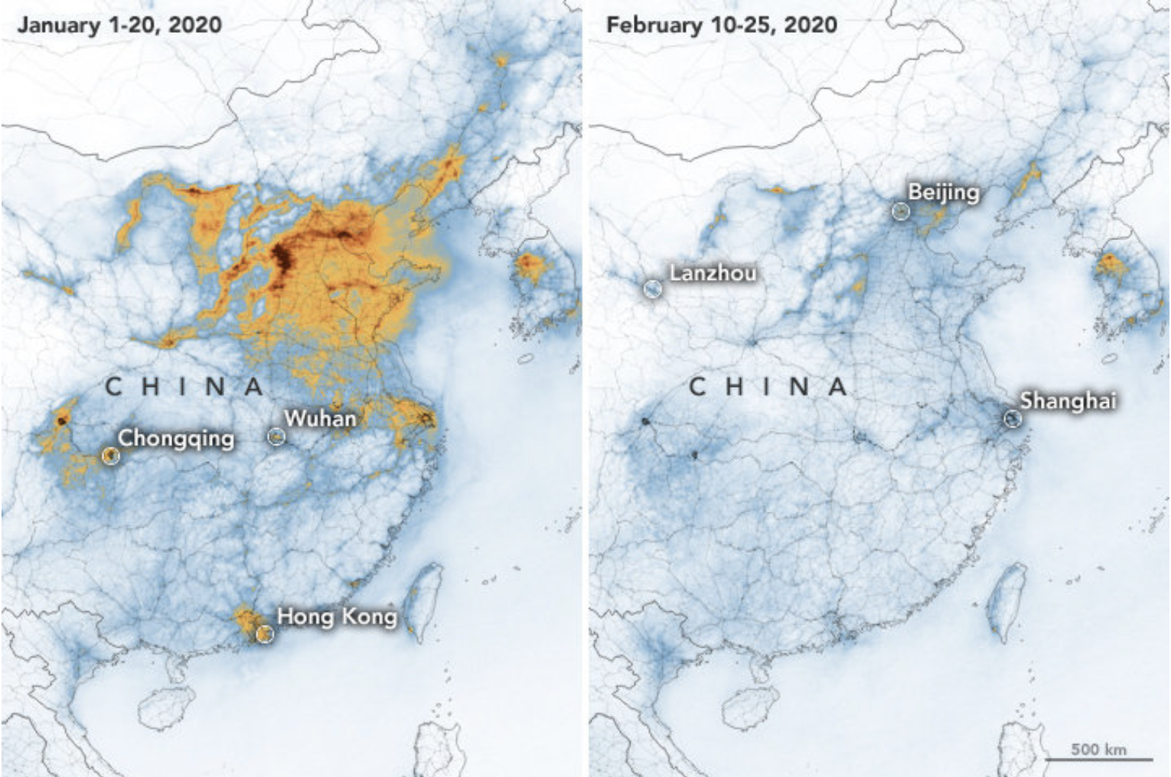
Renewable Energy Curtailment and the Associated Social Welfare Loss in China
Daoru Wang & Weihan Zhang
GLBL 550
Spring 2020

Slide 2
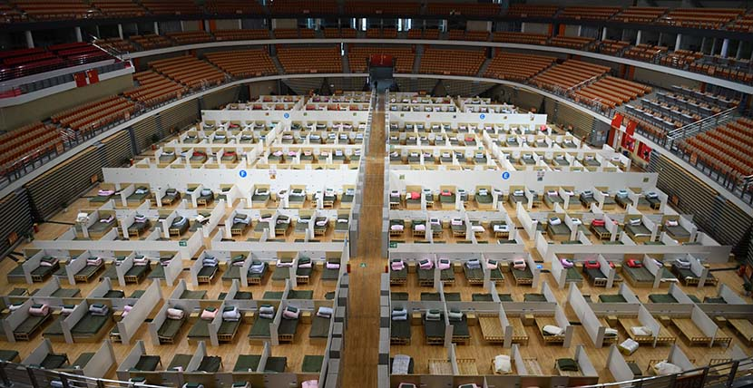

2020 Covid-19 Outbreak
In January 2020, a novel coronavirus disease (COVID-19) outbreak first happened in Wuhan and then quickly spread to the whole country.
Since the beginning of February, the Chinese Government posted one of the strictest emergency responses in human history by banning the traffic mobility and issued a large population shelter in space order in the entire country until the beginning of April.

Slide 3
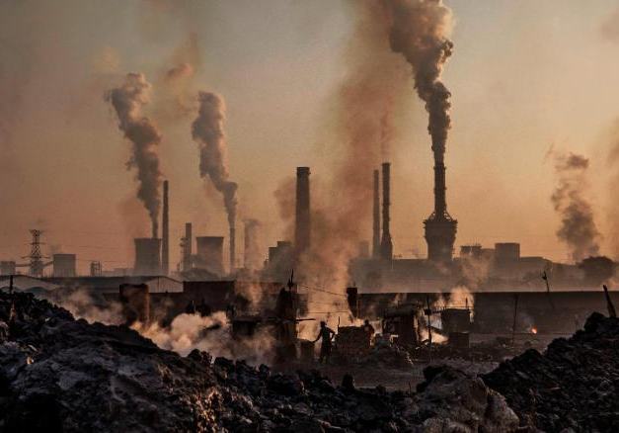
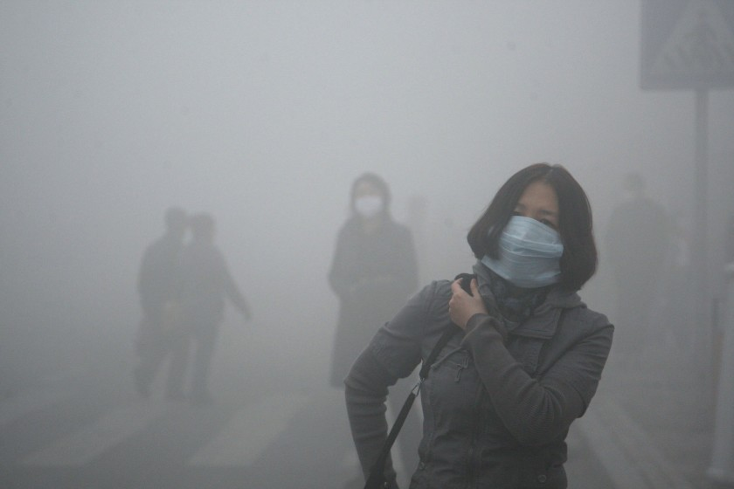
Air Pollution in China
China’s rapid economic development over the past three decades has come with an enormous rise in energy demand. It’s energy-related carbon emissions grew by 6.9 times during this period and has turned China into the world’s largest carbon dioxide emitter.
Government and media have identified massive manufacturing factories and transportation as the top two most significant emitting sectors that contributed to the level of air pollution. Stringent regulations on the emission standards of these sectors have been
proposed to regulate their air pollutant emissions.
Notes:
3

Slide 4
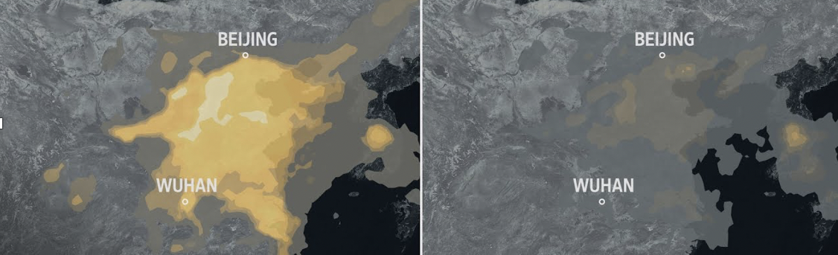
Research Objectives
While facing an unprecedented domestic or even international pandemic due to the COVID-19 outbreak, several media have reported that the air pollution issue in China has been curbed during this lockdown period
The overarching goal of this study is to examine the improvements in air pollution levels during this period due to the massive quarantine.
Specifically, this study:
Investigate the air pollution level for different pollutants among the same period over the past six years in major Chinese cities including Beijing, Shanghai, Wuhan, Guangzhou, Chengdu, and Hongkong;
Compare the effects of this massive quarantine to the effects of previous policies

Slide 5
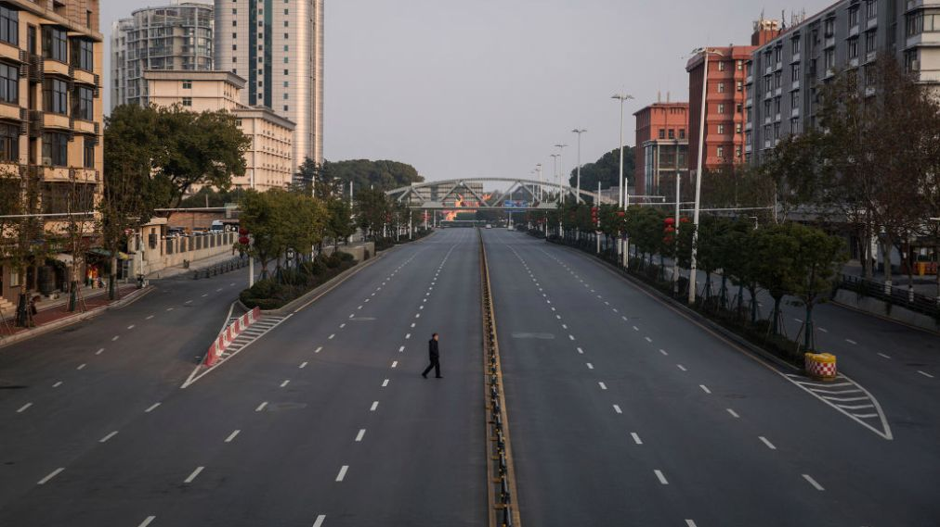
Method
We retrieved the air pollution data for six major cities (Beijing, Shanghai, Wuhan, Guangzhou, Chengdu, and Hongkong) of the same period
(Jan. 1st ~Apr.20th) over the past six years.
For each city, we used the Pandas library in Python to draw the 2-D Line charts for six different major air pollutants (CO, NO2, O3, PM2.5, PM10, and SO2) over the same period over the past six years.
Then we finished formulating a small software using Python that after inputting the name of the city and the pollutant, it will automatically show up the comparison graphs.
Notes:
5

Slide 6
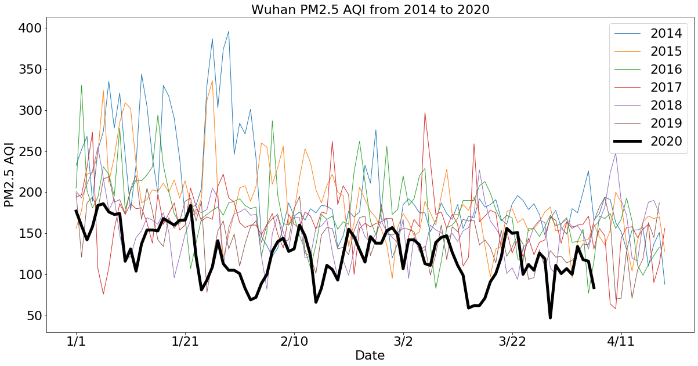
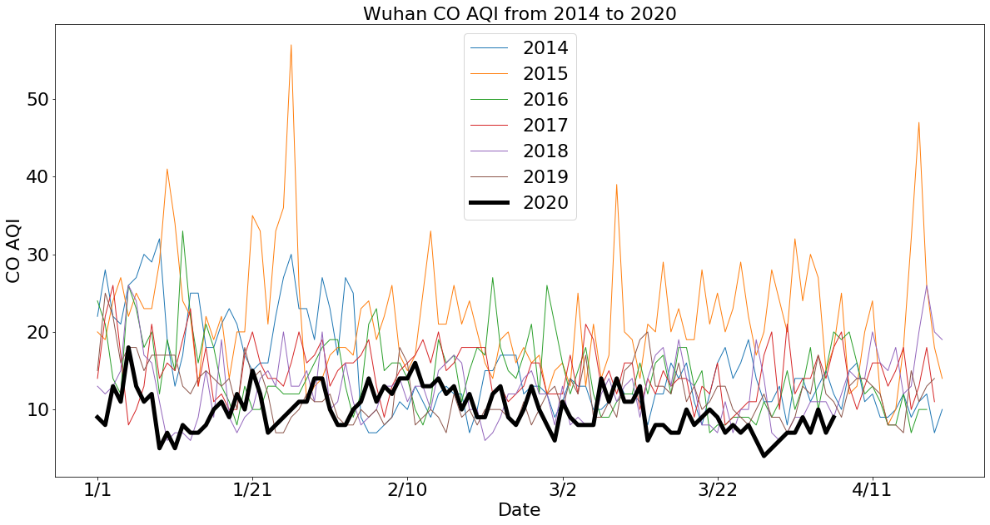
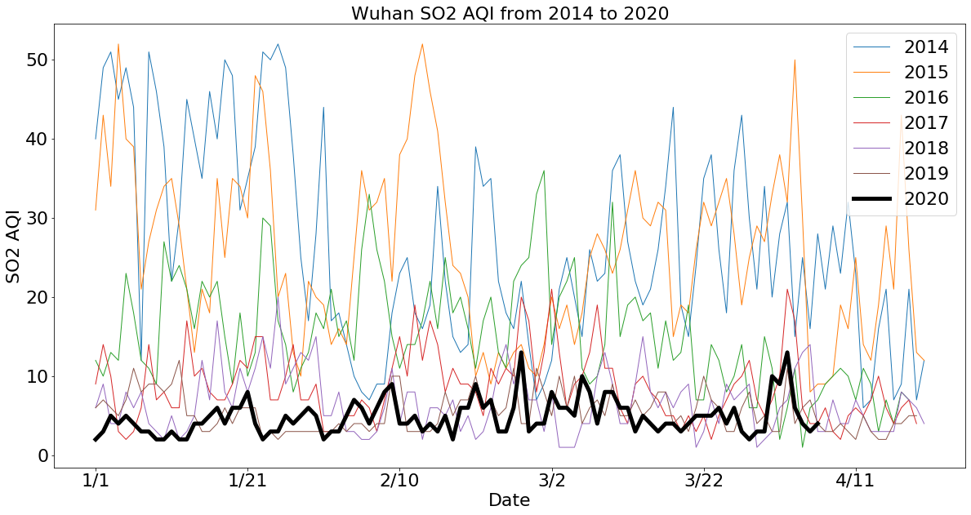
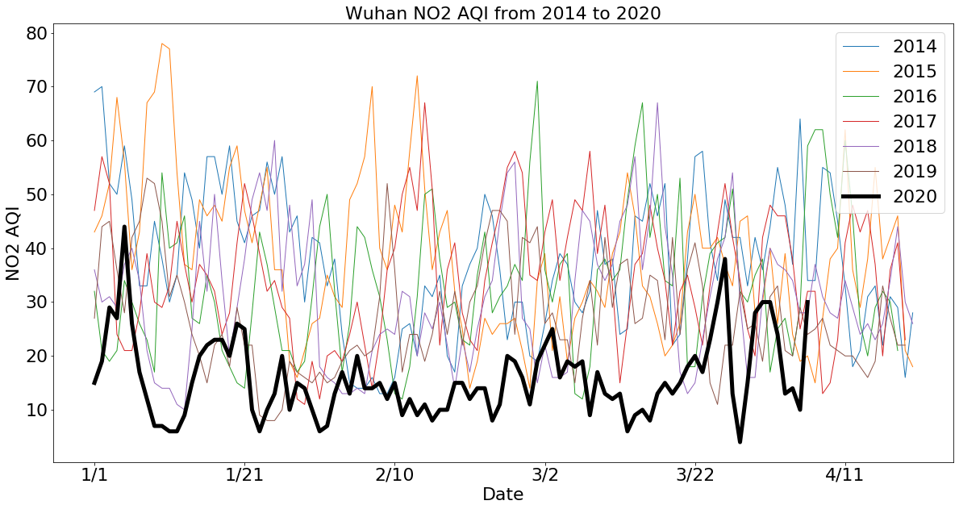
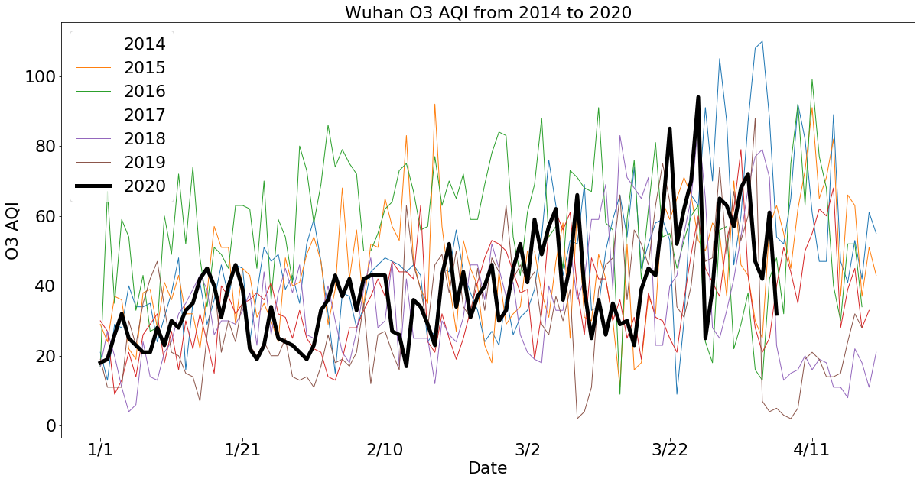
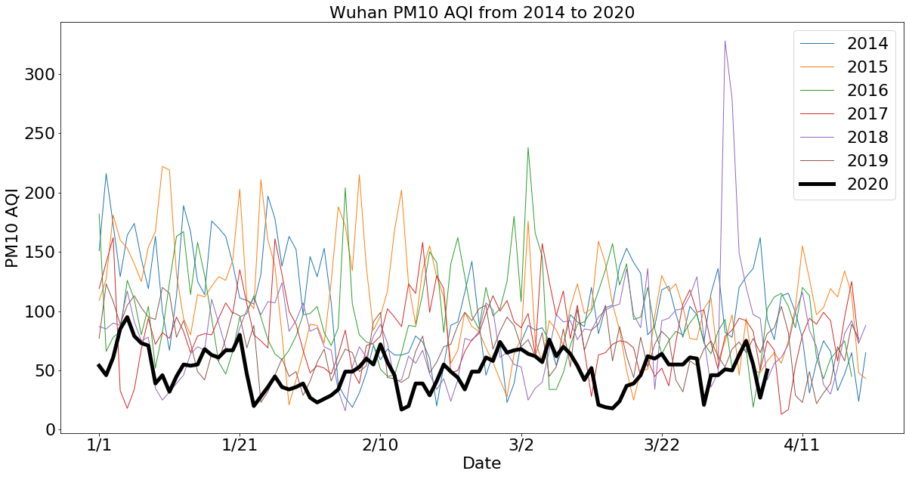
Results
Wuhan
Notes:
6

Slide 7
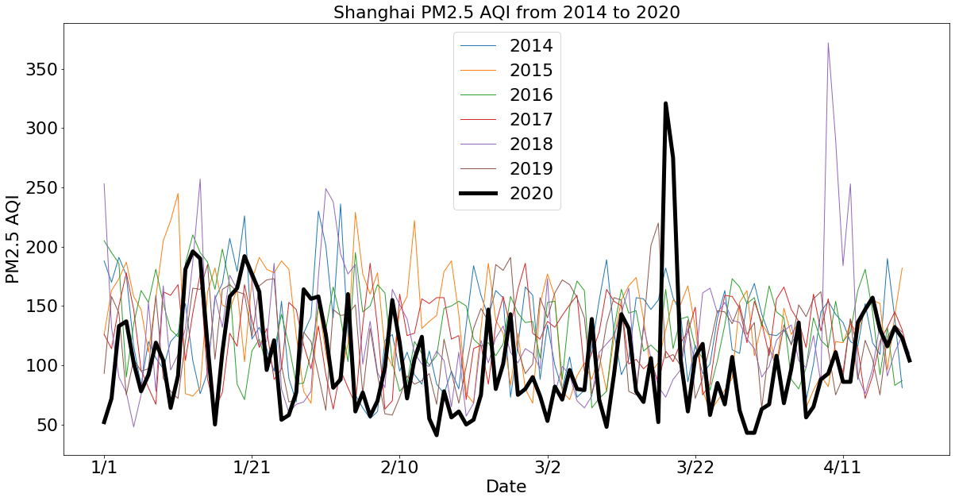
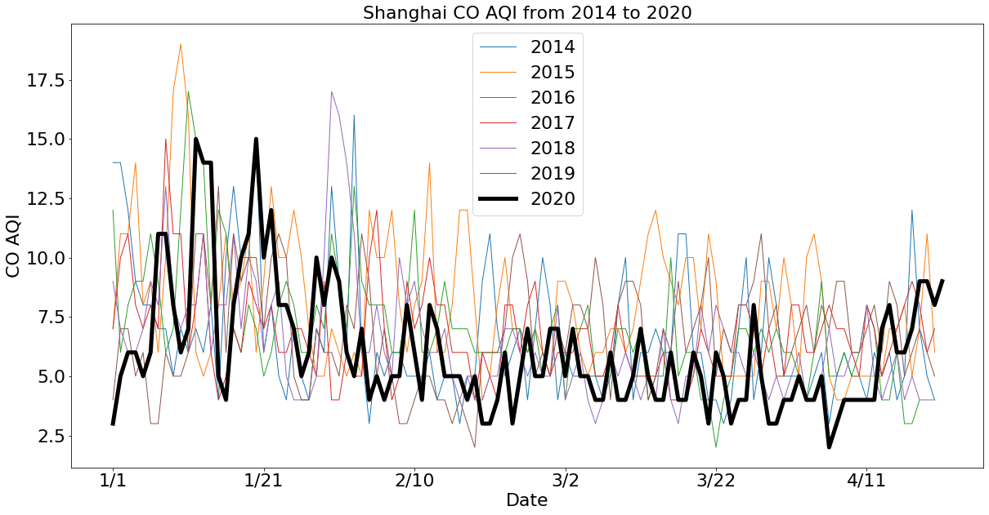
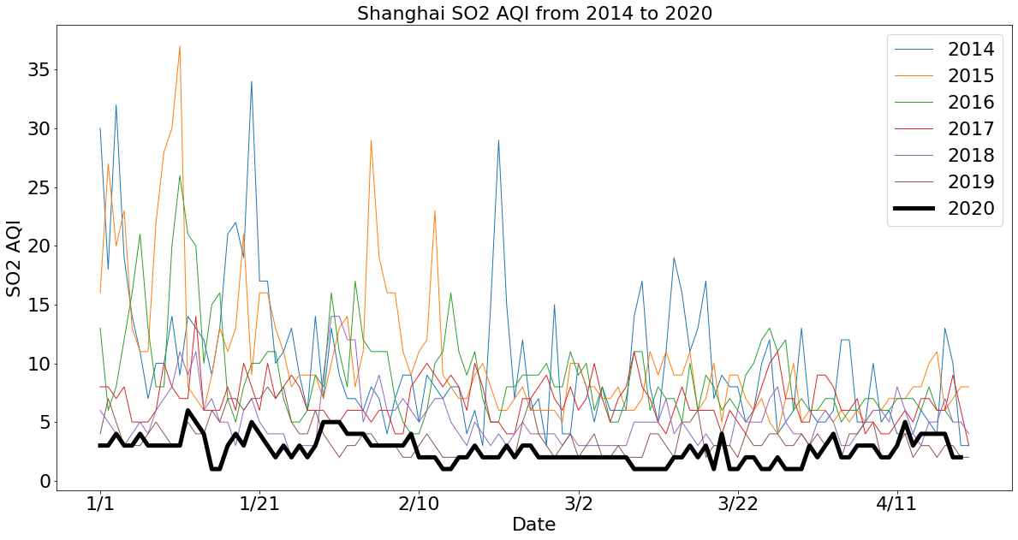
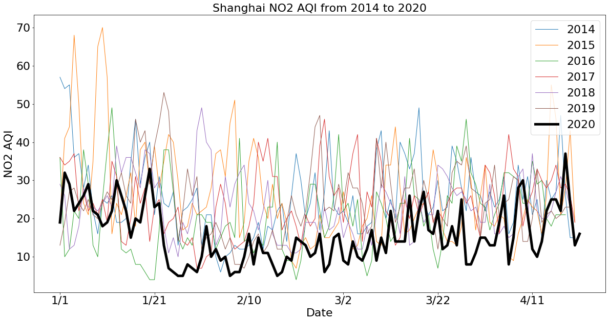
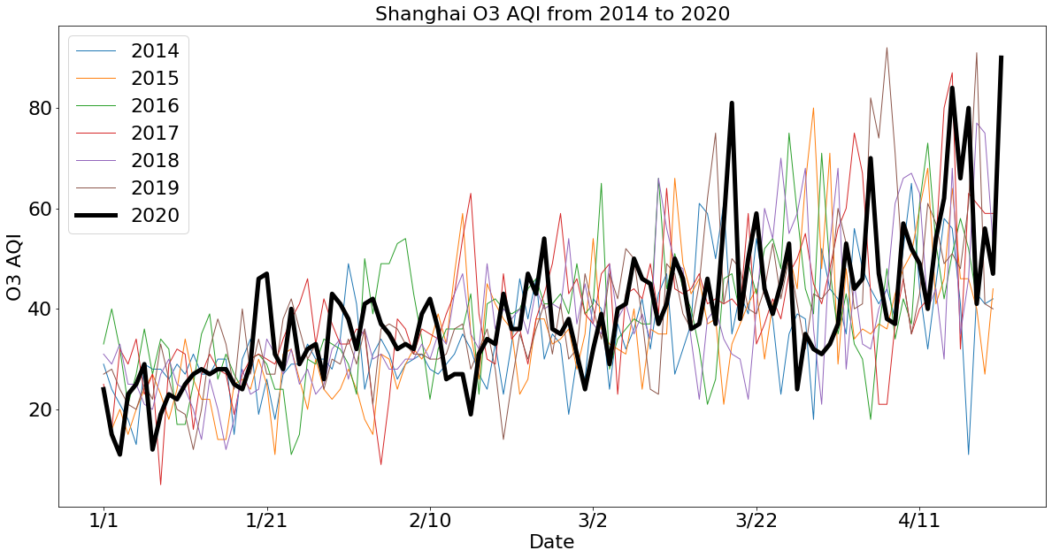
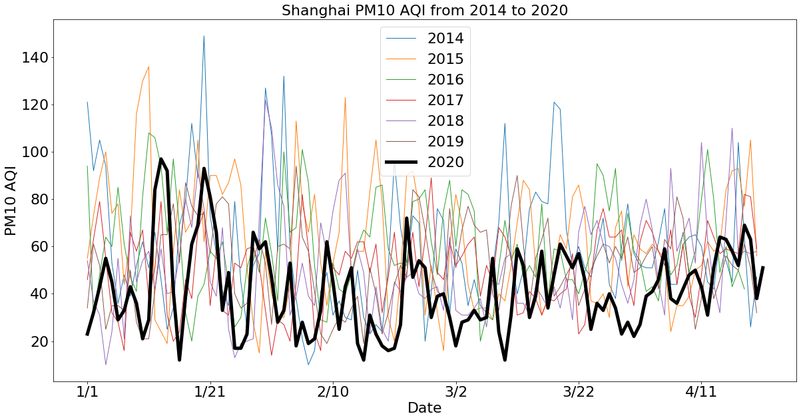
Results
Shanghai
Notes:
7

Slide 8
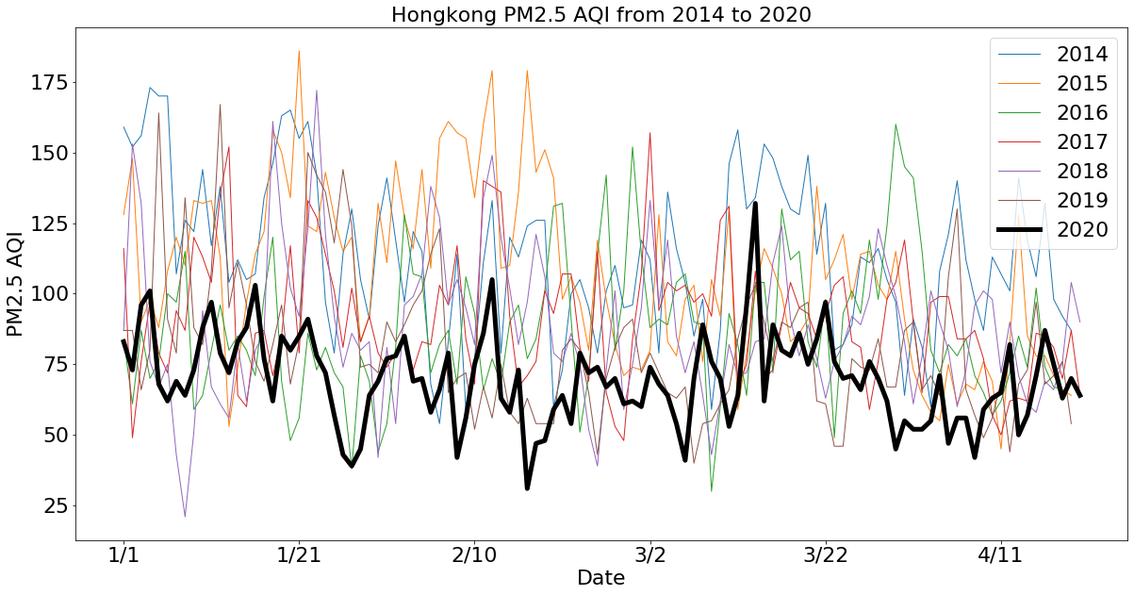
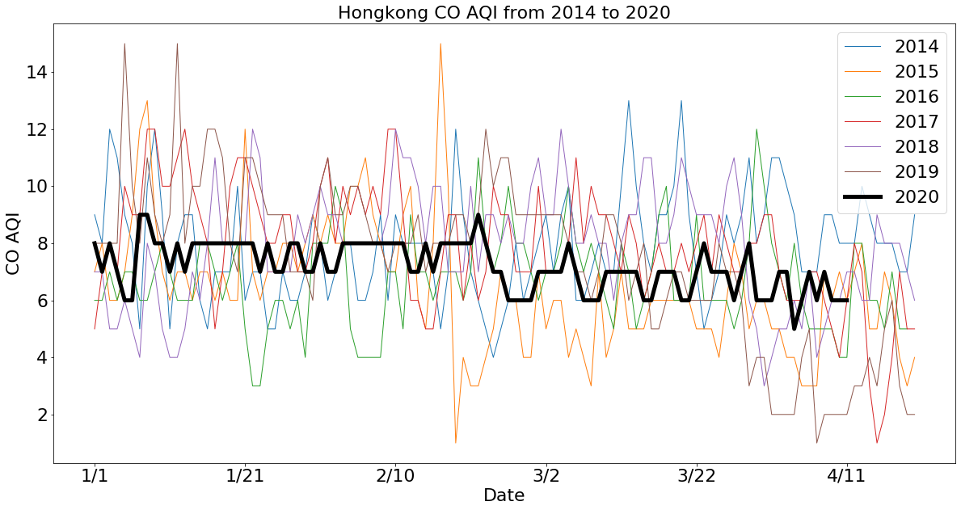
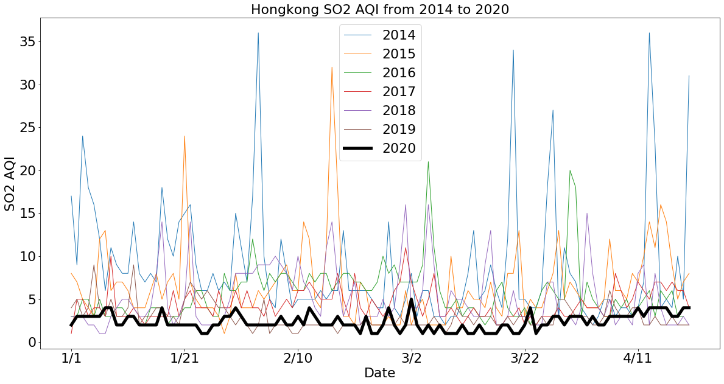
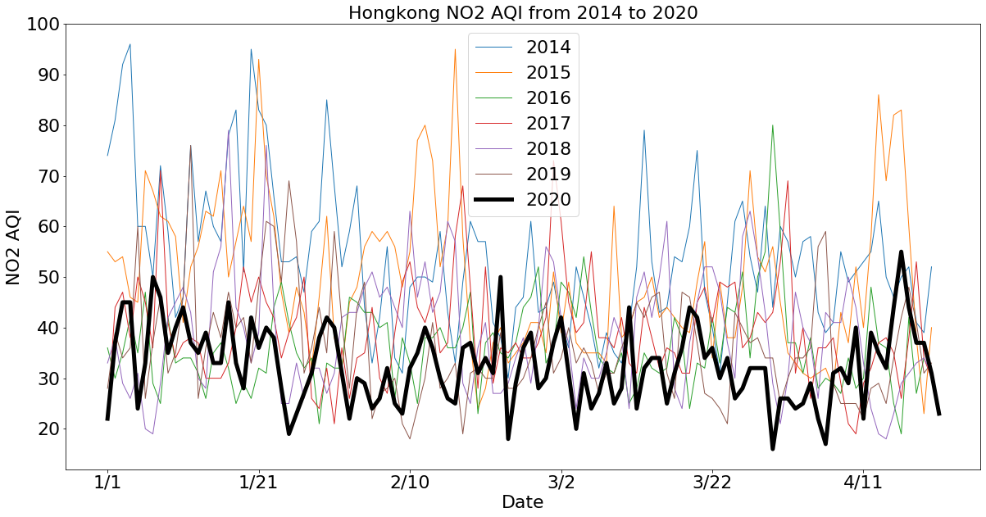
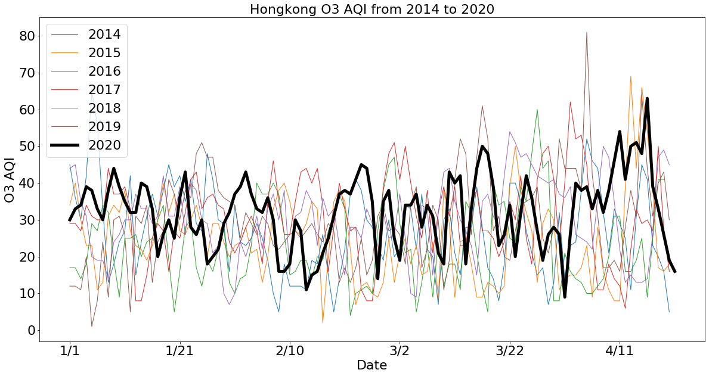
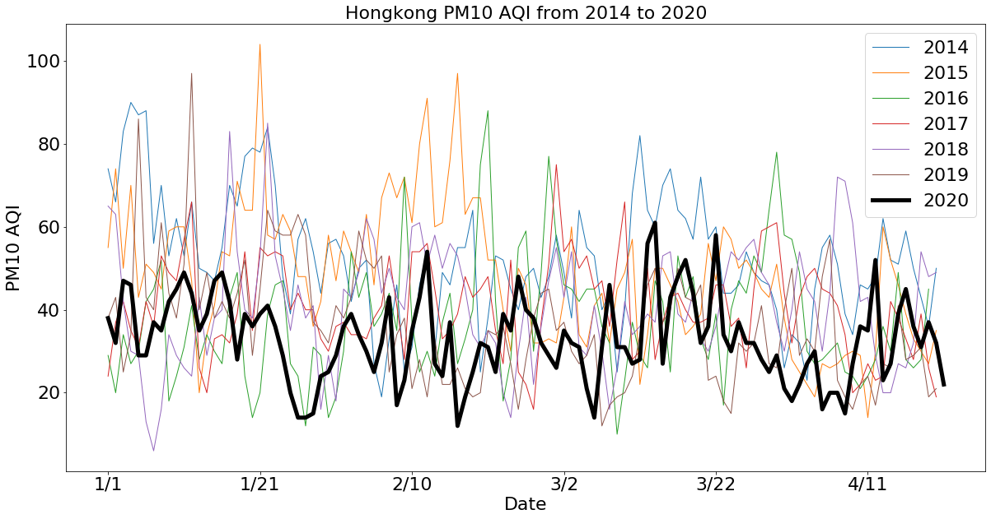
Results
Hongkong
Notes:
8

Slide 9
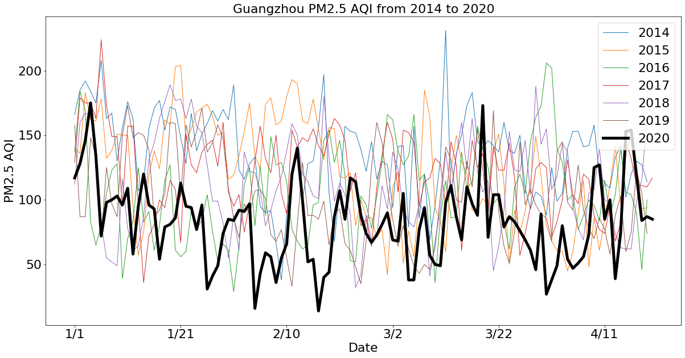
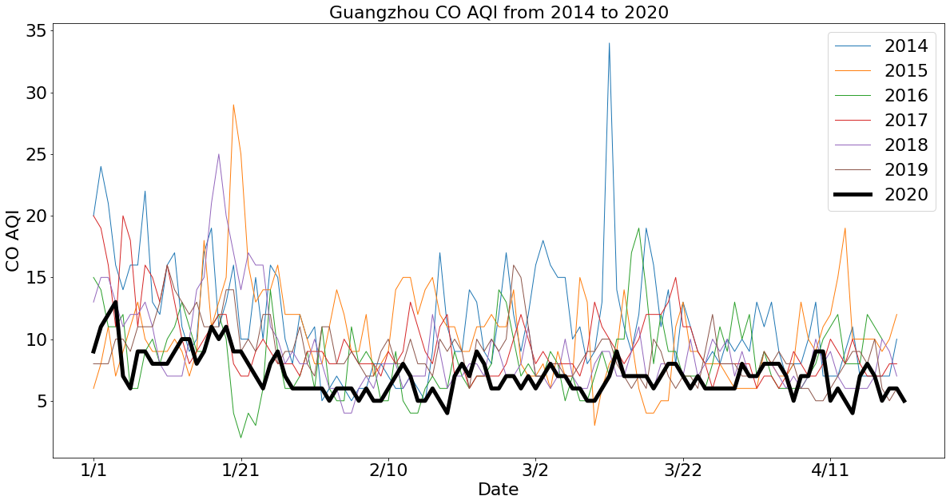
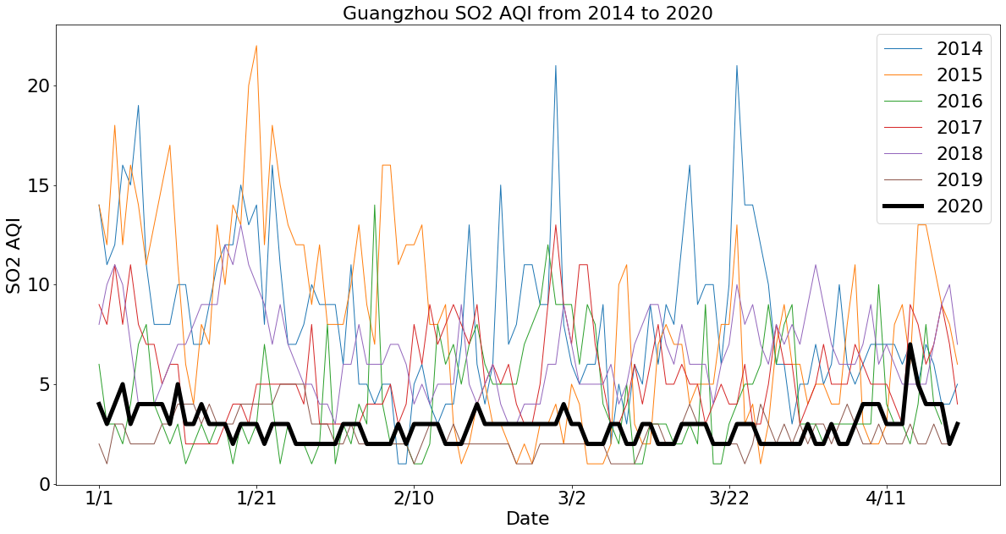
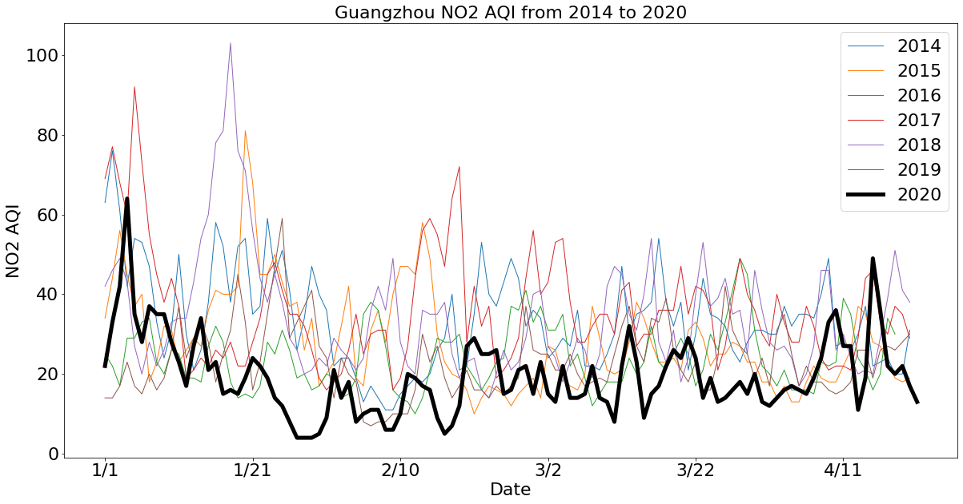
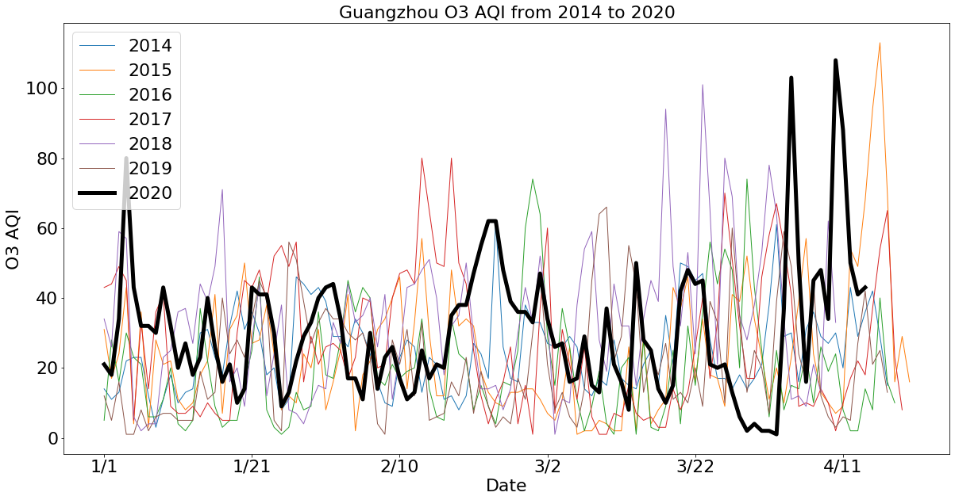
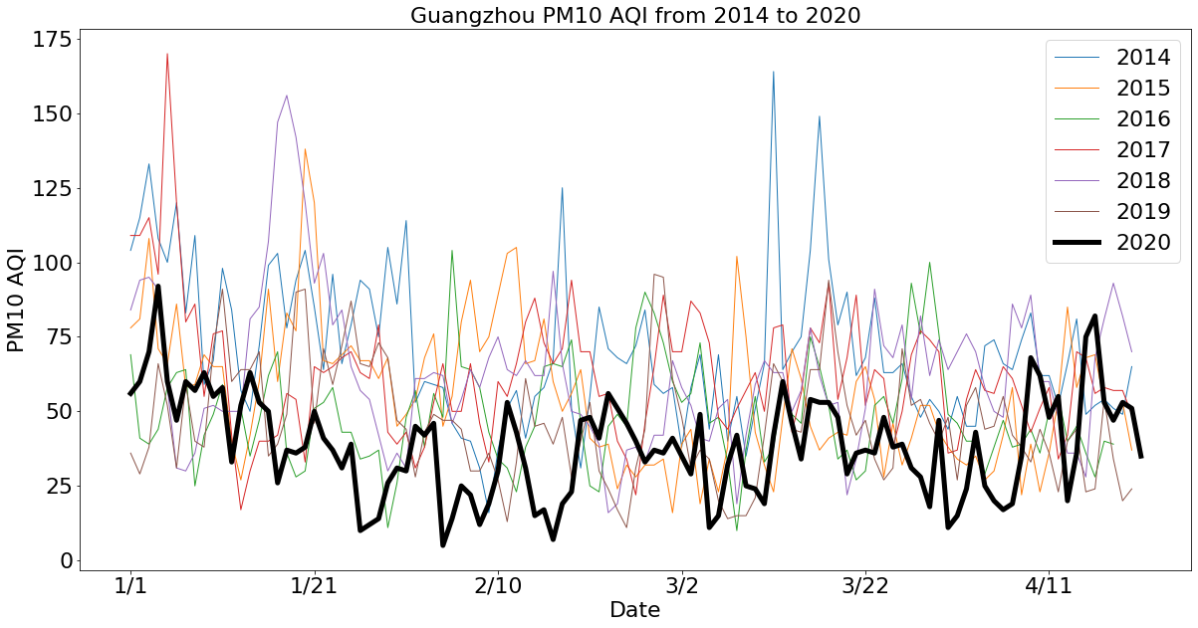
Results
Guangzhou
Notes:
9

Slide 10
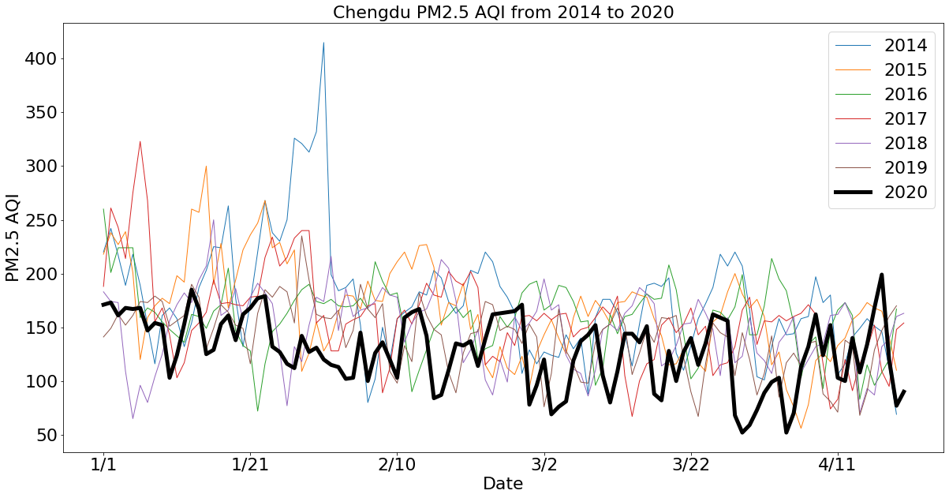
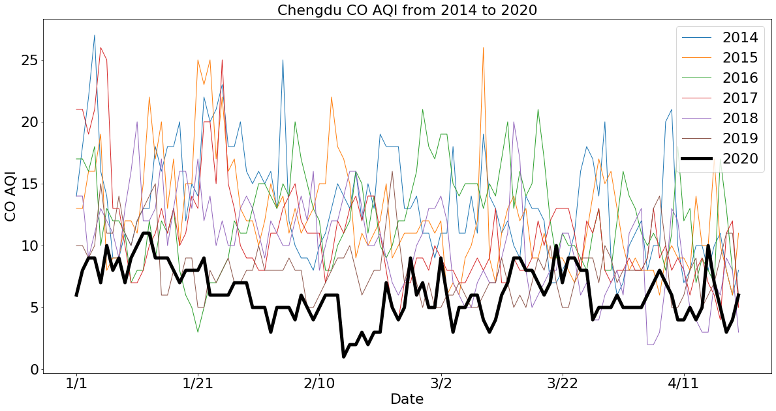
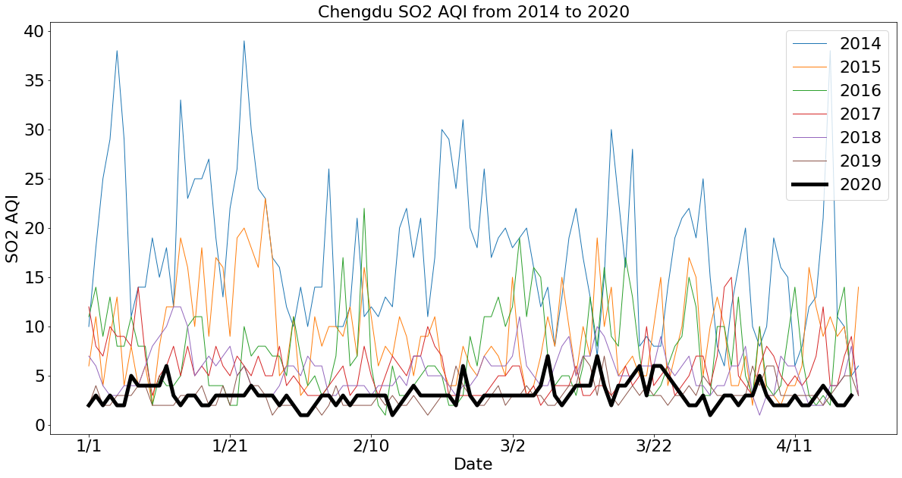
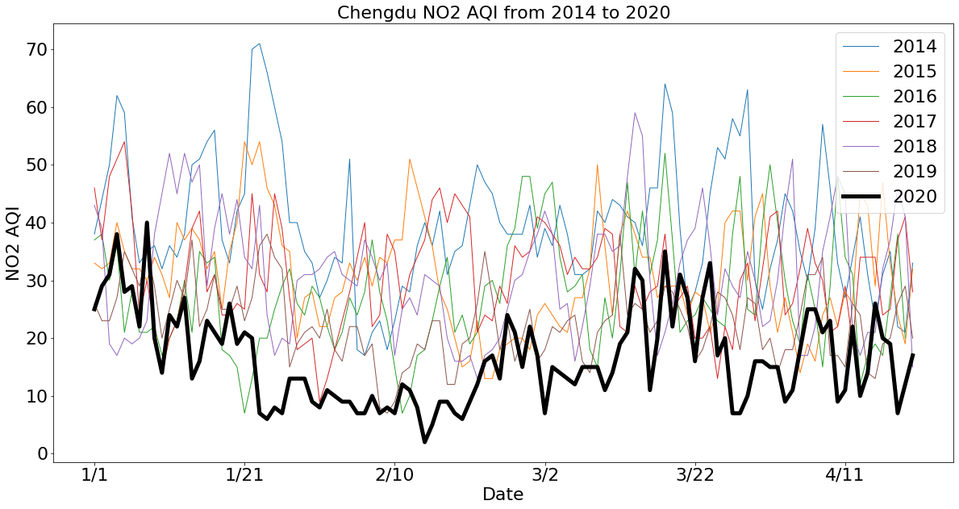
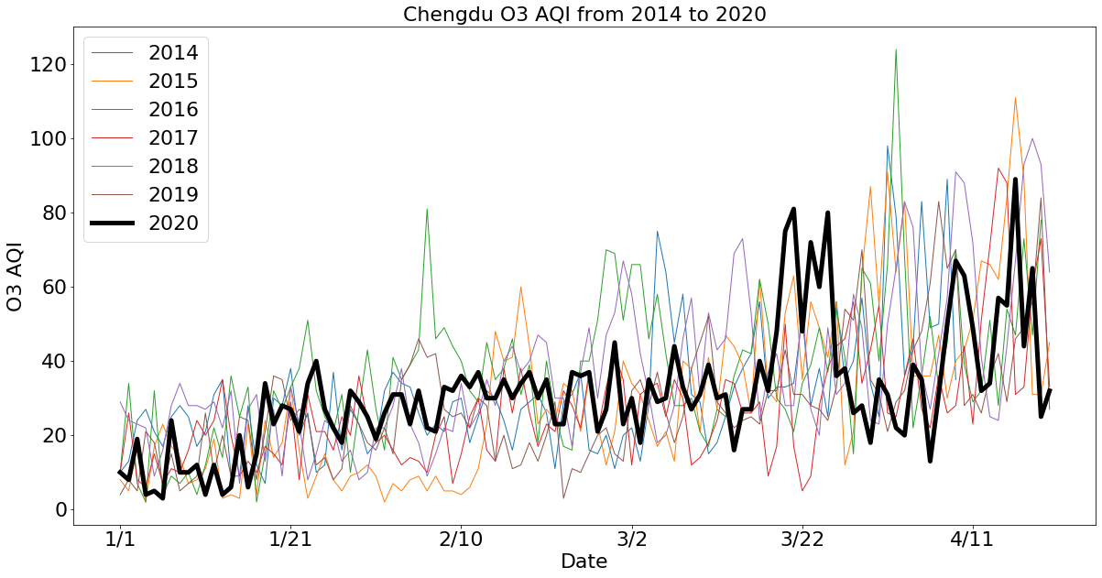
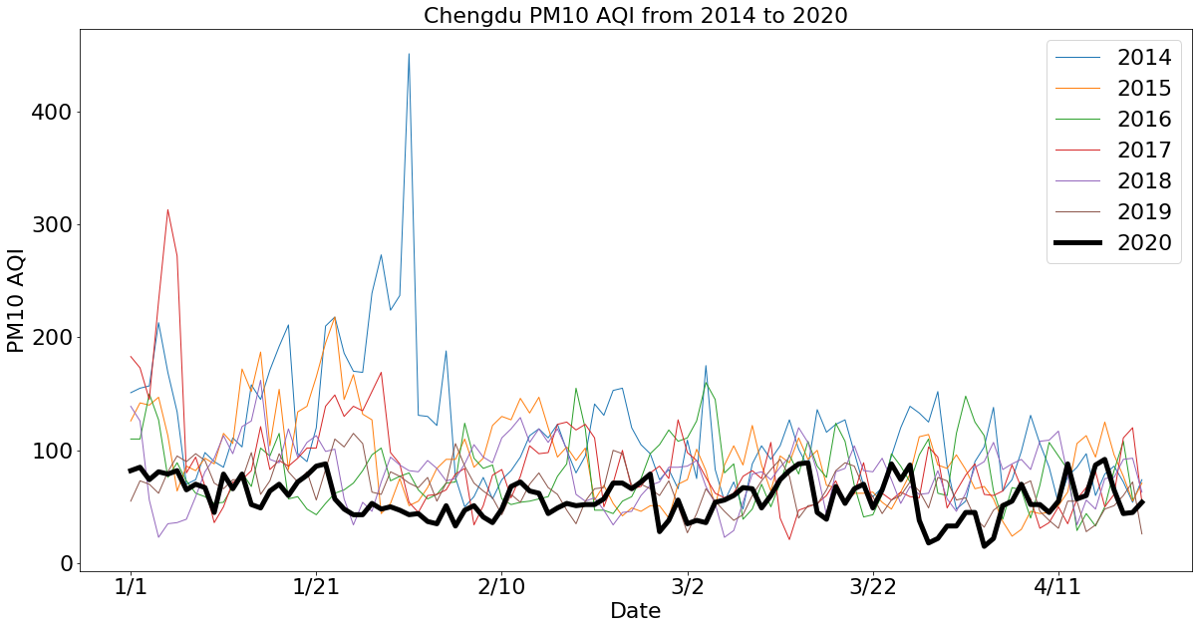
Results
Chengdu
Notes:
10

Slide 11
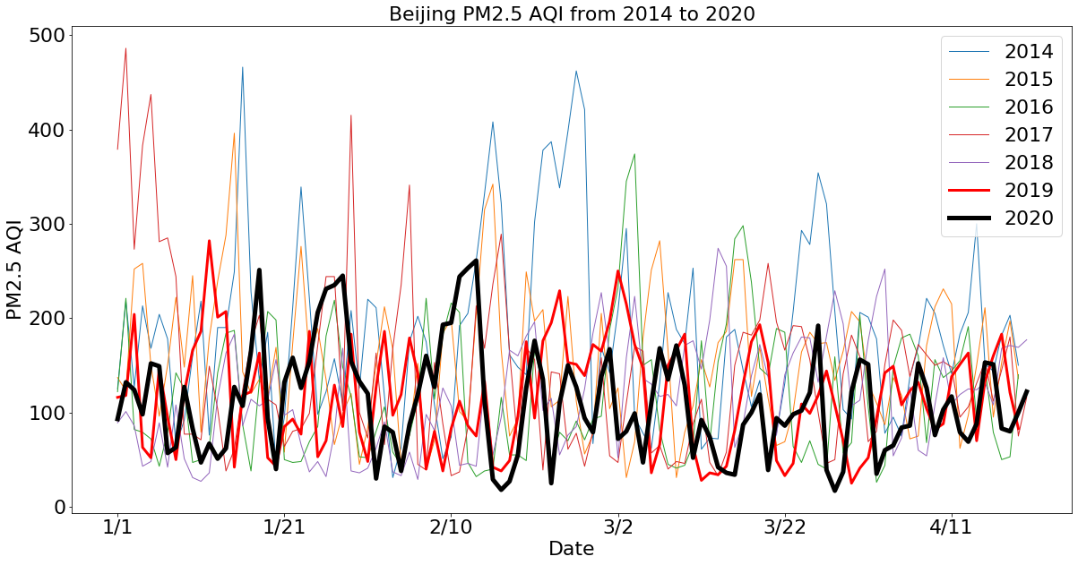
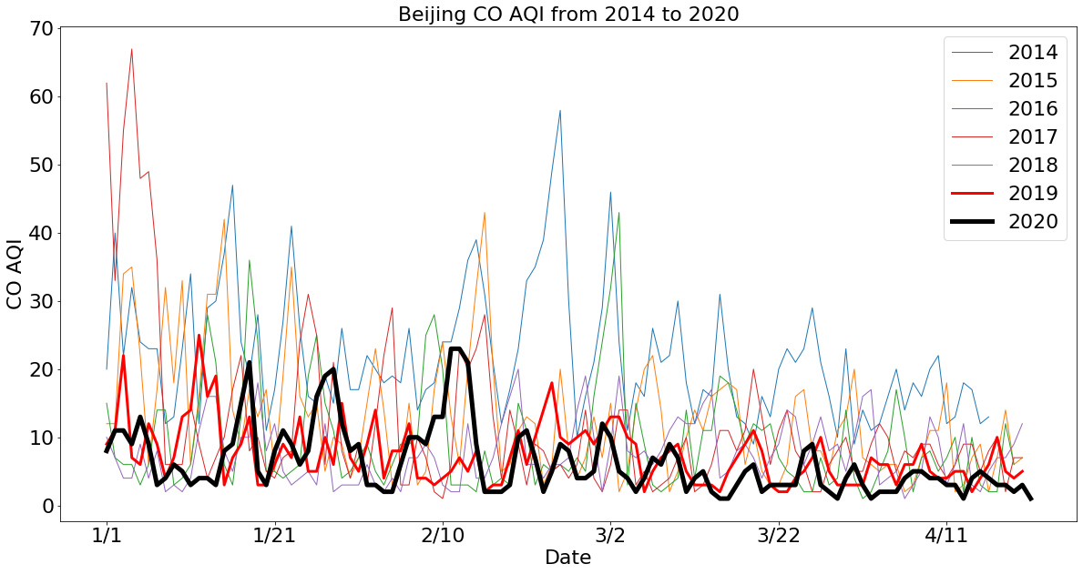
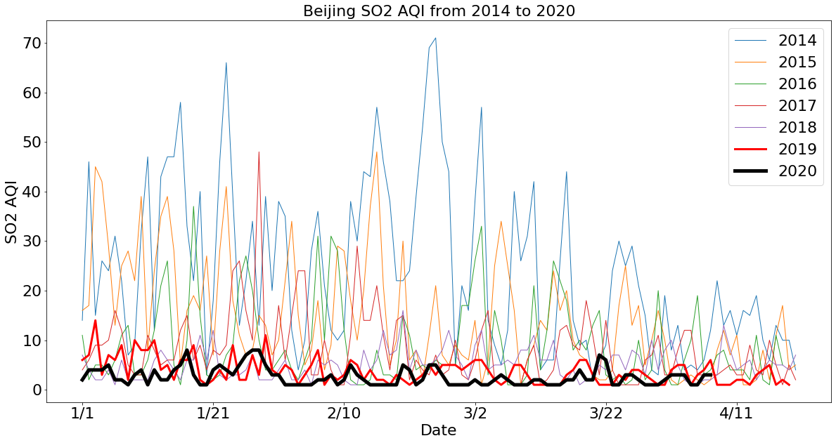
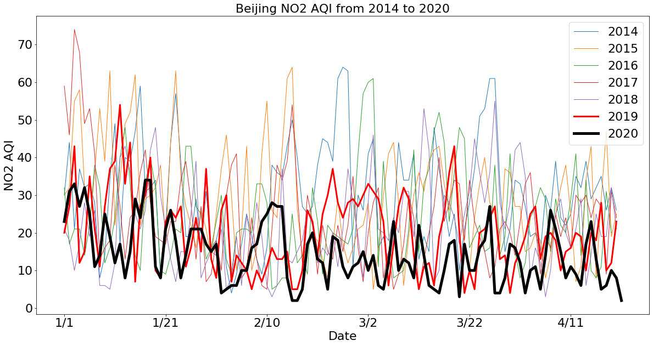
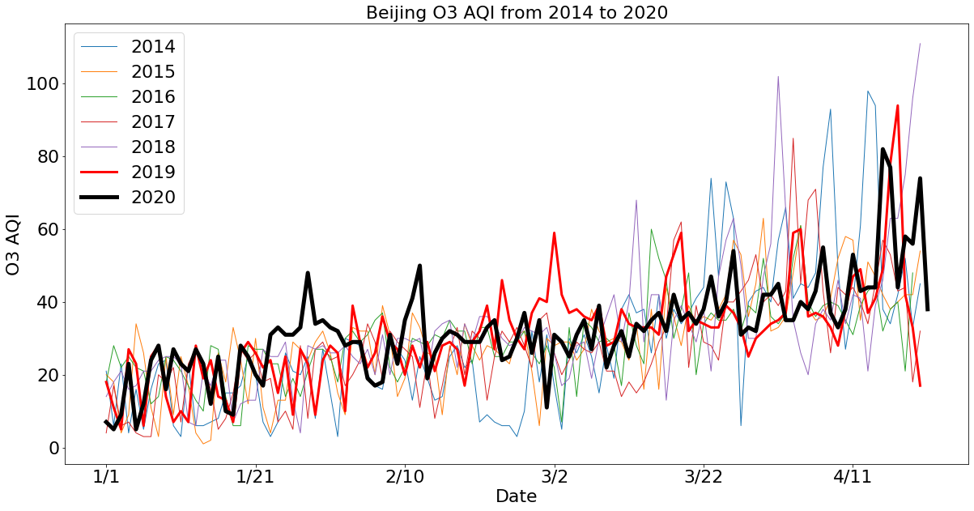
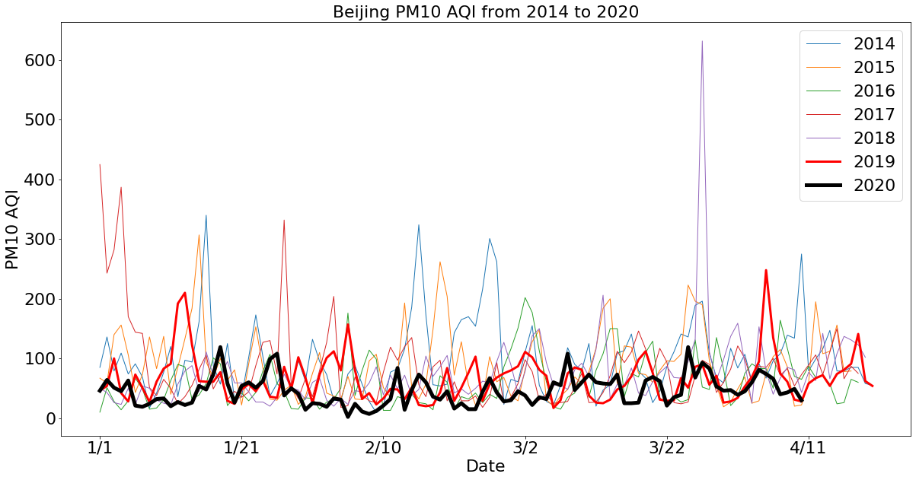
Results
Beijing
Notes:
11

Slide 13
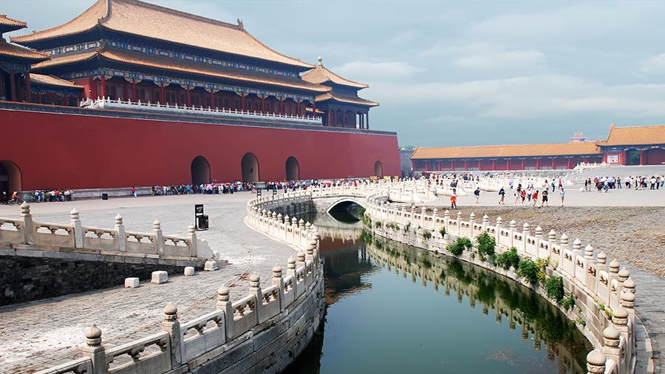
Discussion/Future Directions
This massive quarantine in China has led to a substantial improvement in the air quality in major Chinese cities;
Furthermore, it has shown that its effect is still strong even after very stringent policies have been proposed in previous years.
This study could be further improved to include considering and quantifying other co-benefits of this improvement in air quality such as the drops of mortality rate associated.
Notes:
13

